Slide 1
Deep Learning for Signal Image Processing
21AIE312

Slide 2
Neural Style Transfer

Slide 3
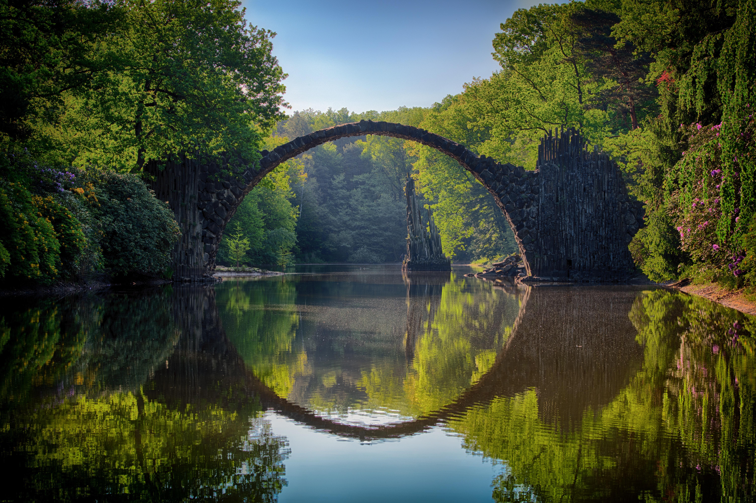
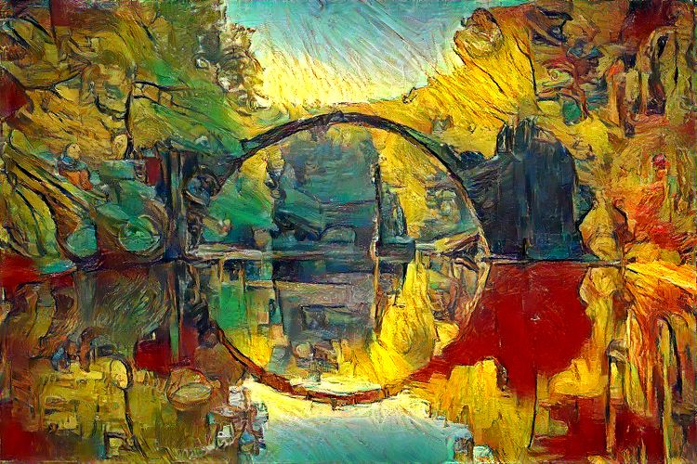
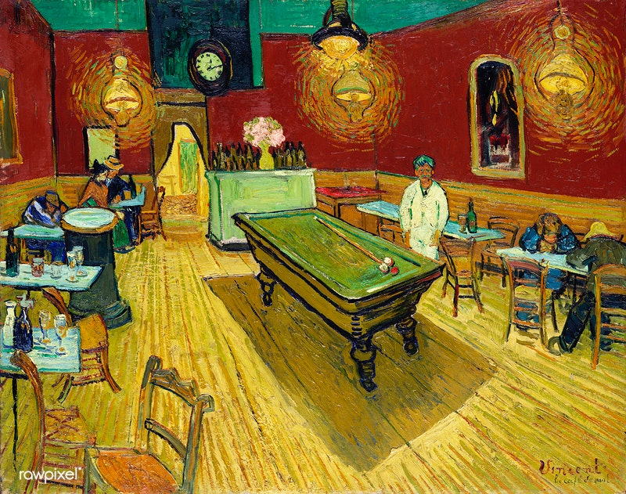
Style Transfer Task
+

Slide 4
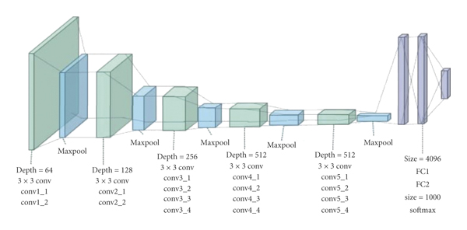
VGG 19 - Architecture

Slide 5
VGG 19 - Architecture
A fixed size of (224 * 224) RGB image was given as input to this network which means that the matrix was of shape (224,224,3).
The only preprocessing that was done is that they subtracted the mean RGB value from each pixel, computed over the whole training set.
Used kernels of (3 * 3) size with a stride size of 1 pixel, this enabled them to cover the whole notion of the image.
spatial padding was used to preserve the spatial resolution of the image.
max pooling was performed over a 2 * 2 pixel windows with sride 2.
this was followed by Rectified linear unit(ReLu) to introduce non-linearity to make the model classify better and to improve computational time as the previous models used tanh or sigmoid functions this proved much better than those.
implemented three fully connected layers from which first two were of size 4096 and after that a layer with 1000 channels for 1000-way ILSVRC classification and the final layer is a softmax function.

Slide 6
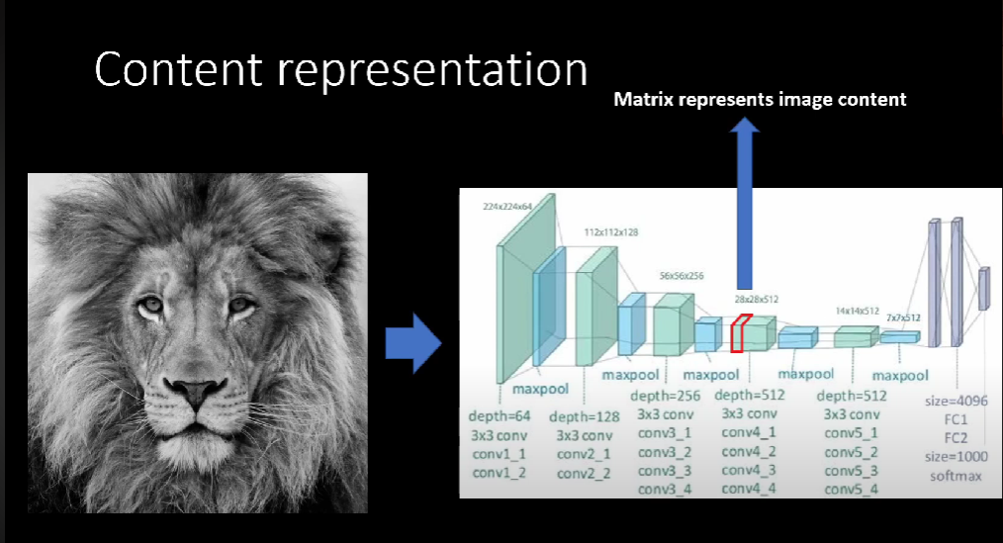
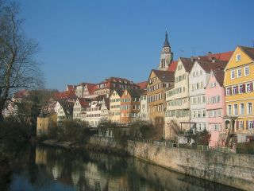

Slide 7
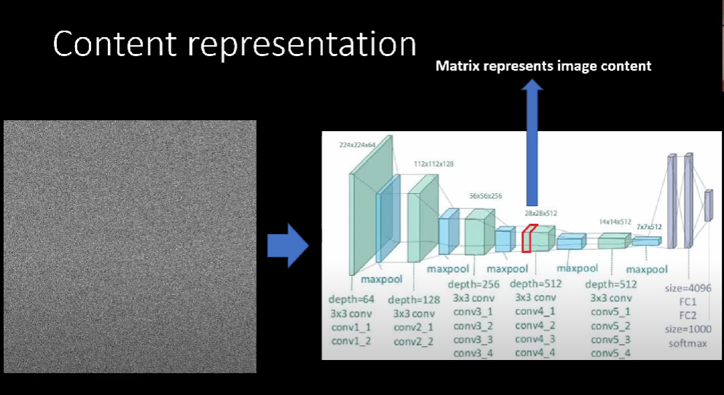

Slide 8
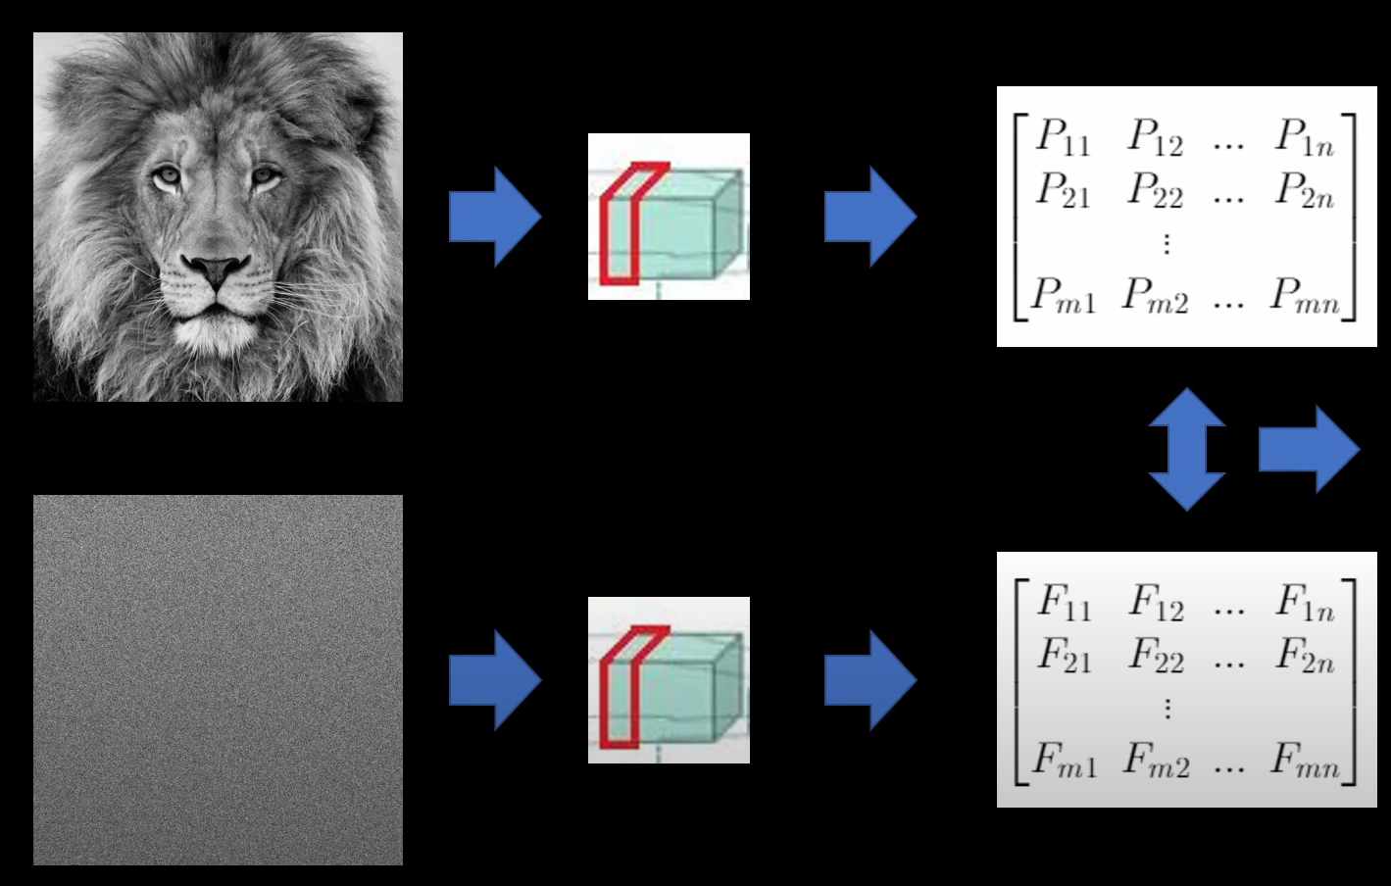
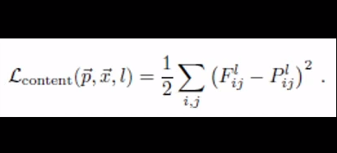

Slide 9
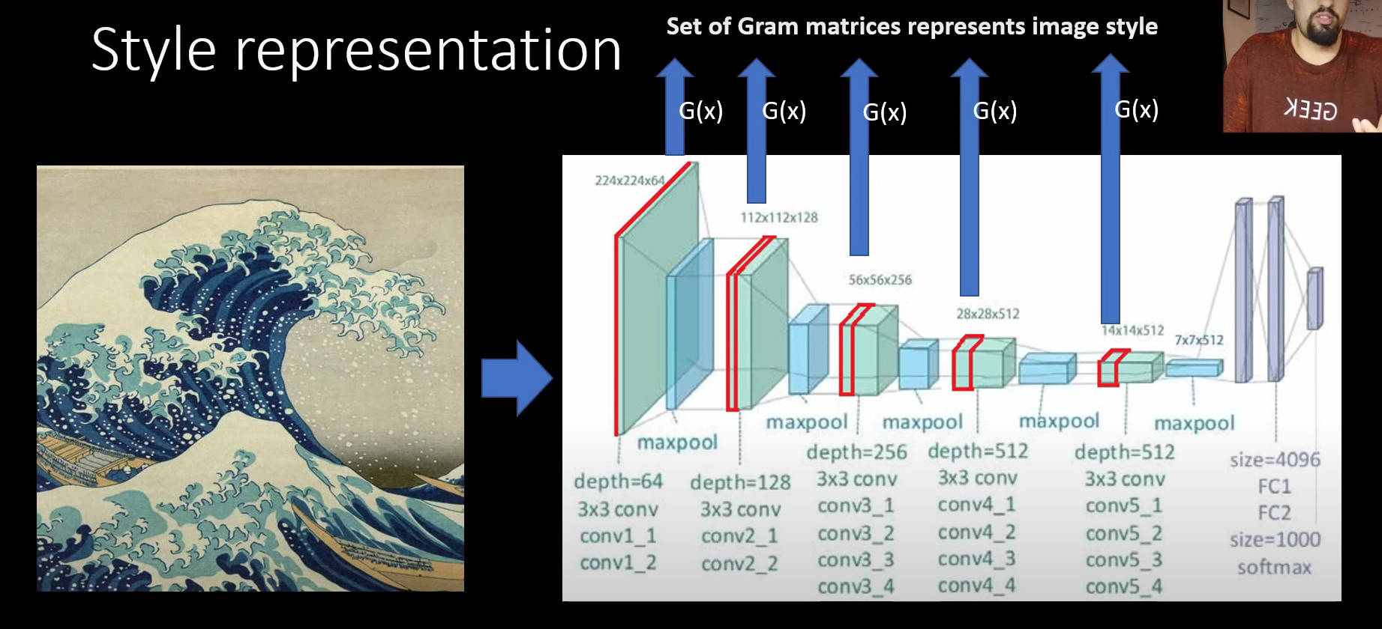
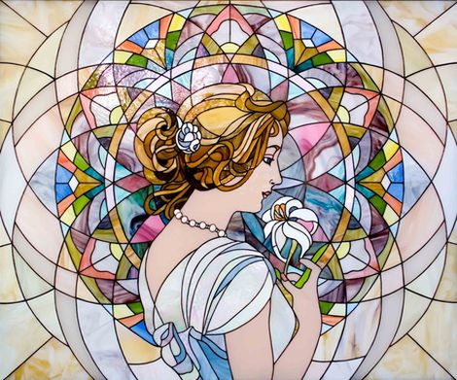
Construct feature space over the feature maps using GRAM transform. Basically we create GRAM matrices from the feature maps.

Slide 10
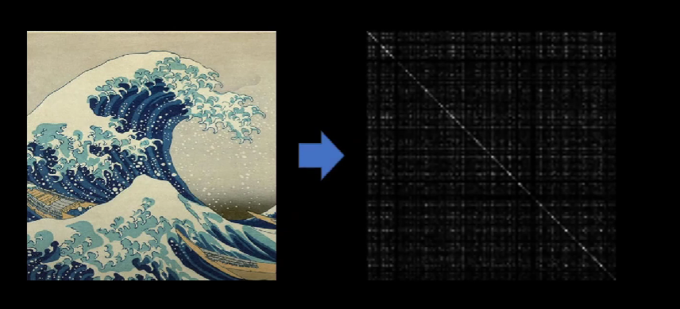
What is Gram Matrix?
If we pass the image through VGG and if we find the gram from one of the CNN this is how the gram looks like.

Slide 11
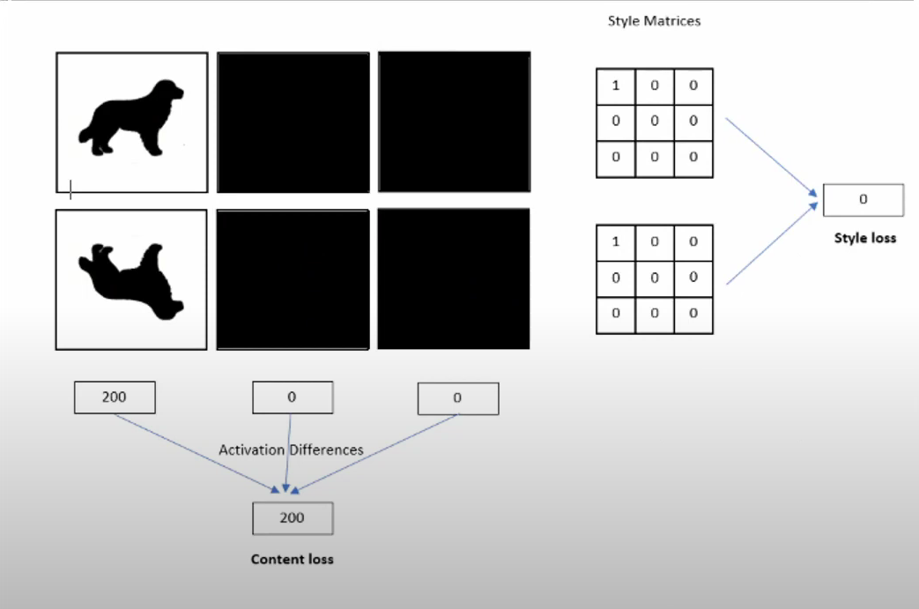
How Gram works?

Slide 12
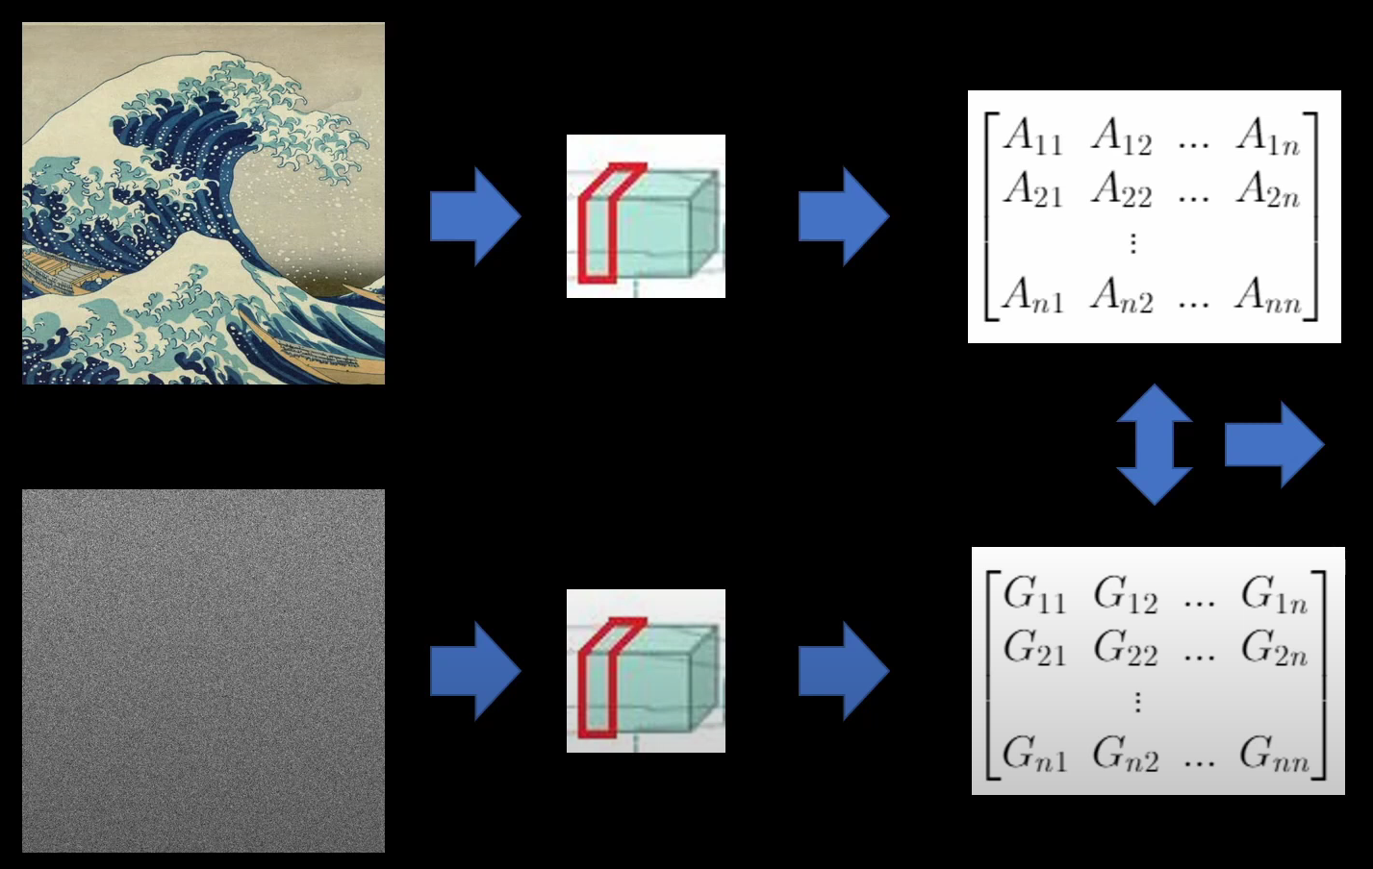
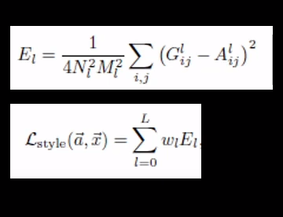

Slide 13
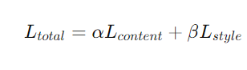

Slide 15
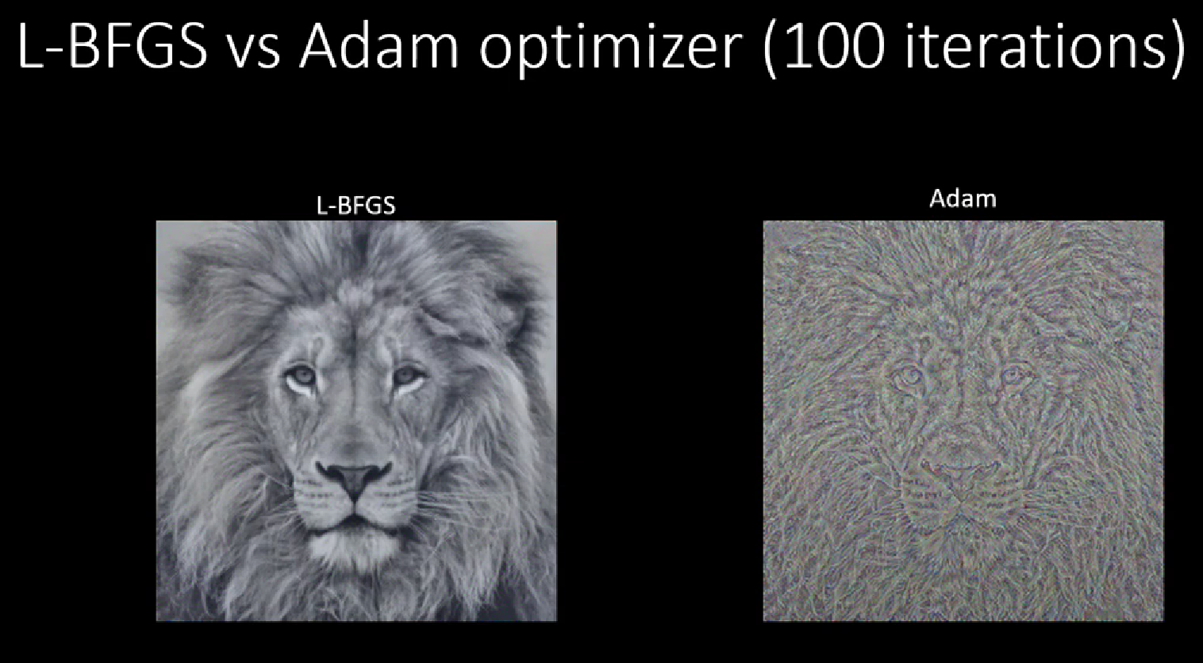

Slide 16
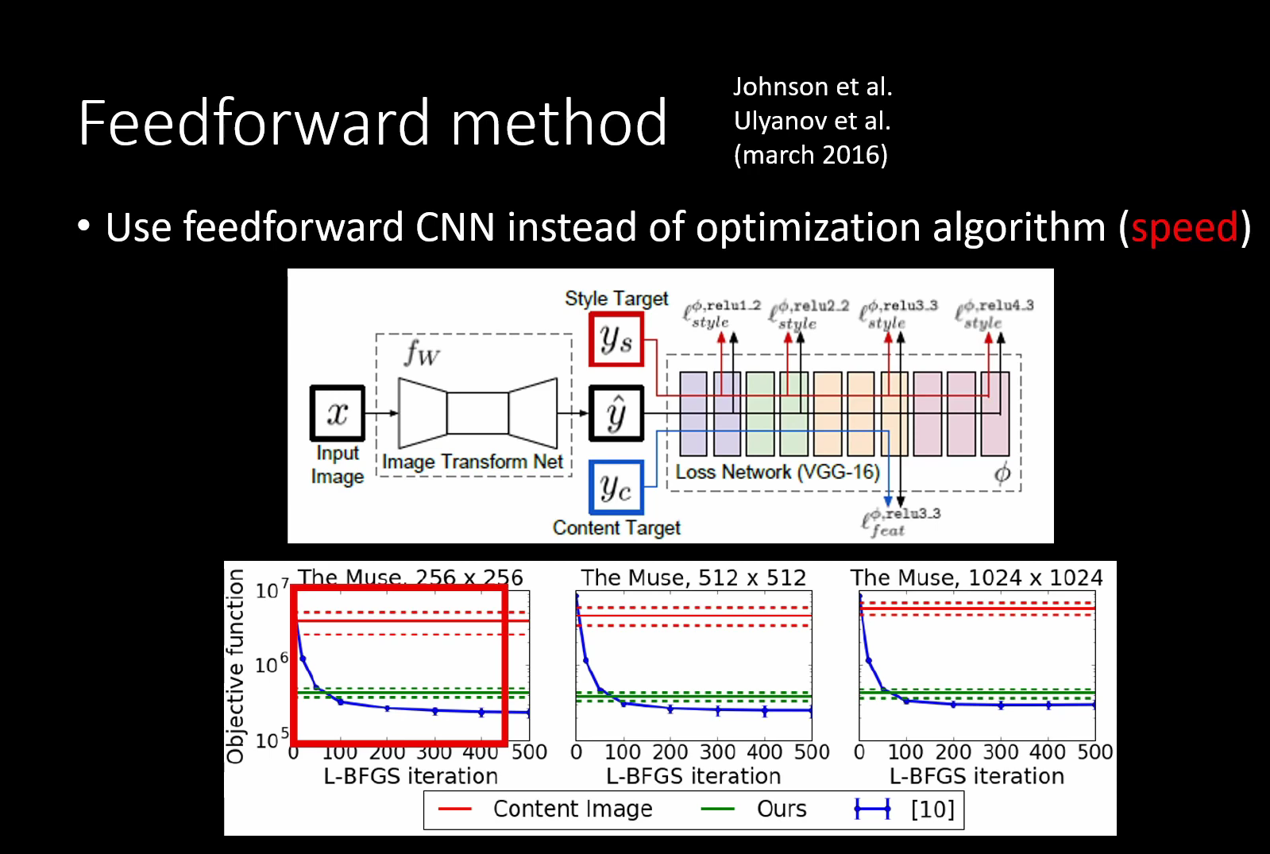

Slide 17
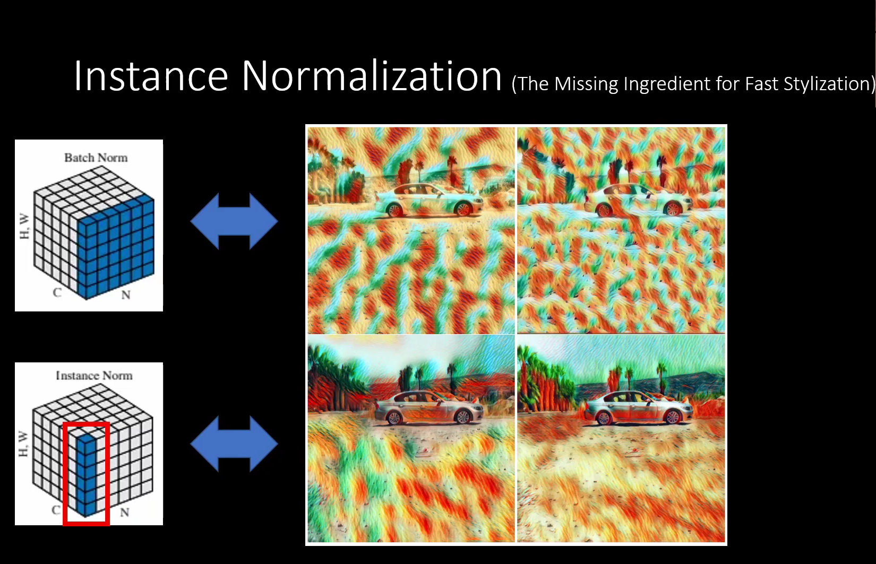

Slide 18
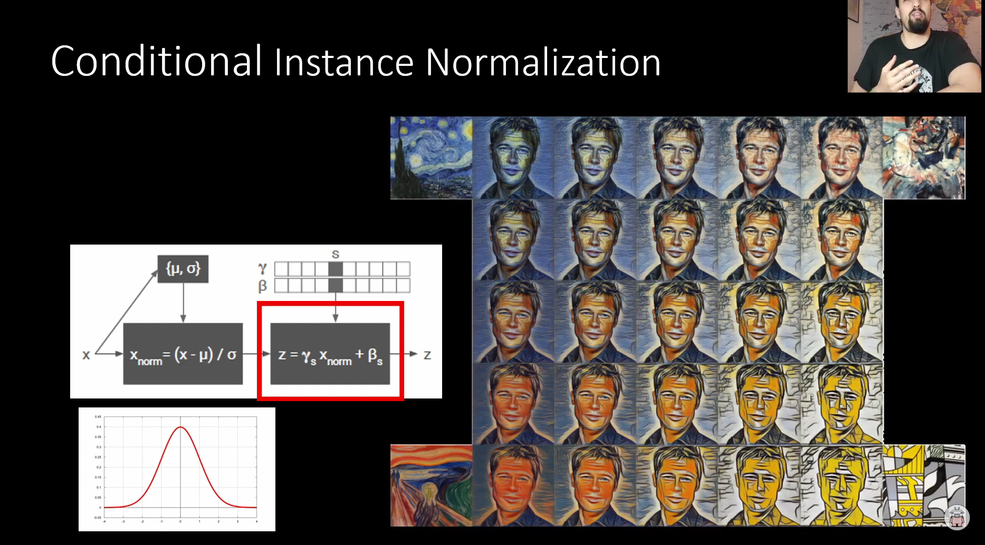
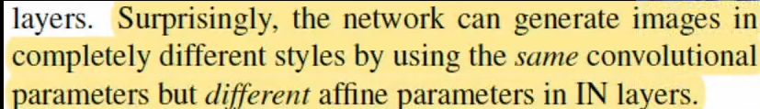

Slide 19
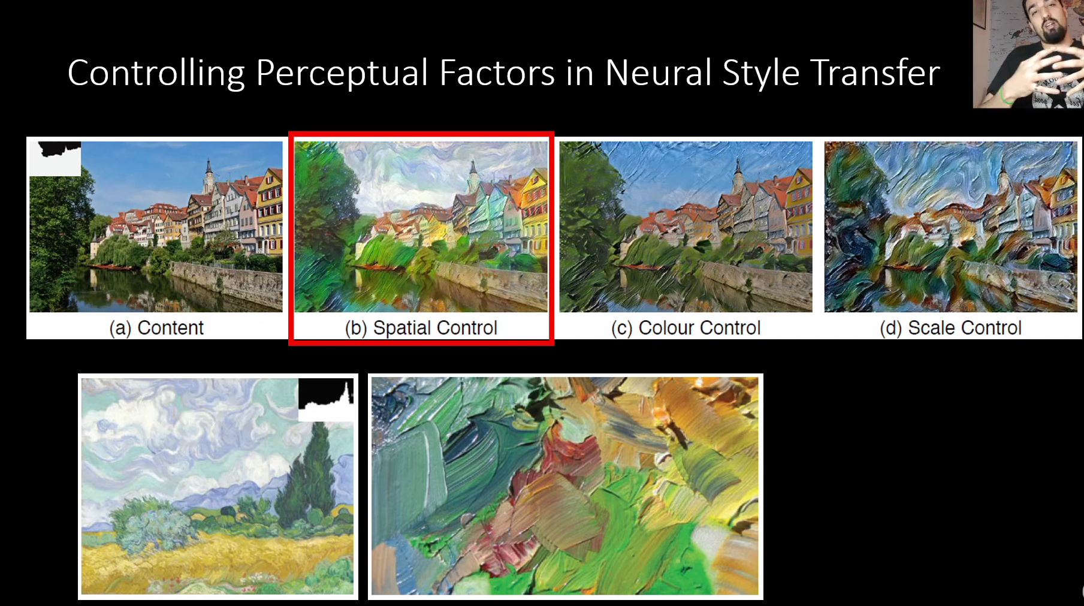

Slide 20
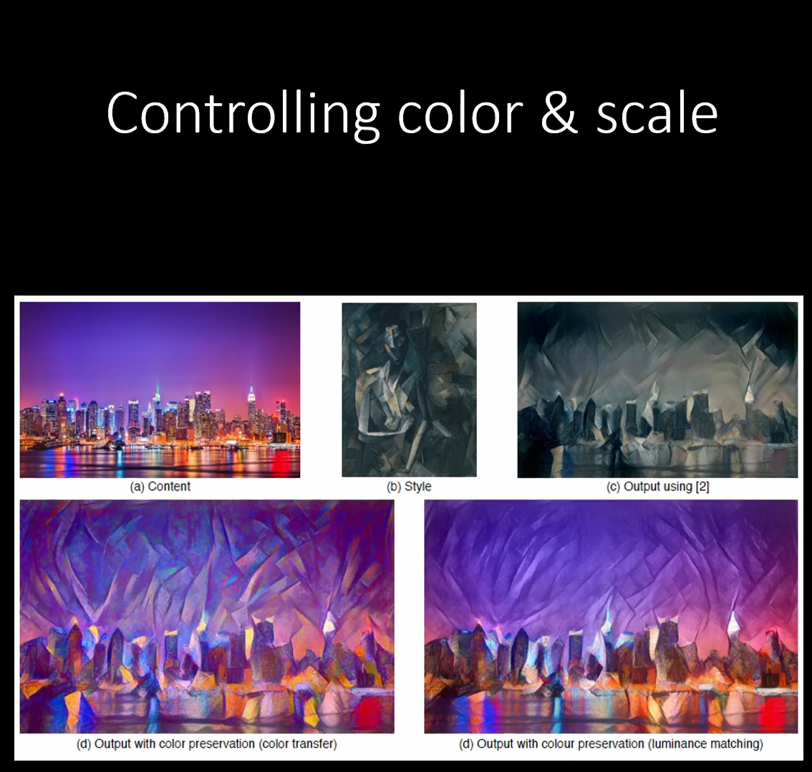

Slide 21
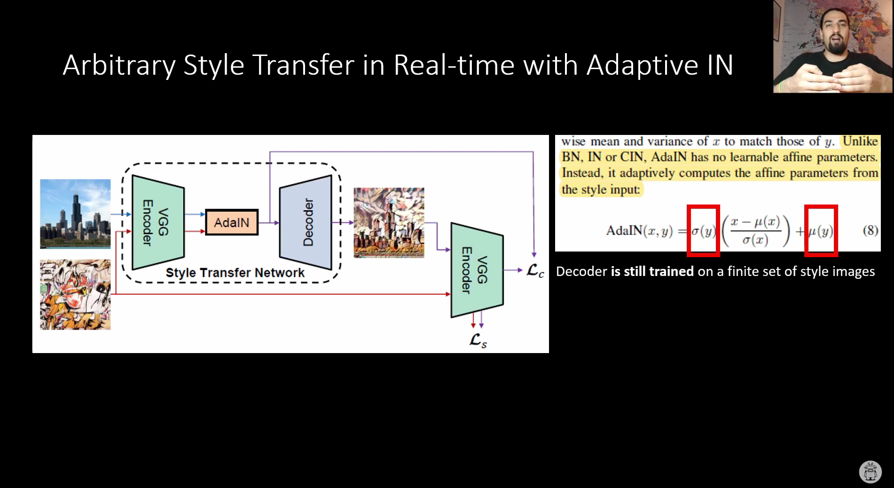

Slide 22
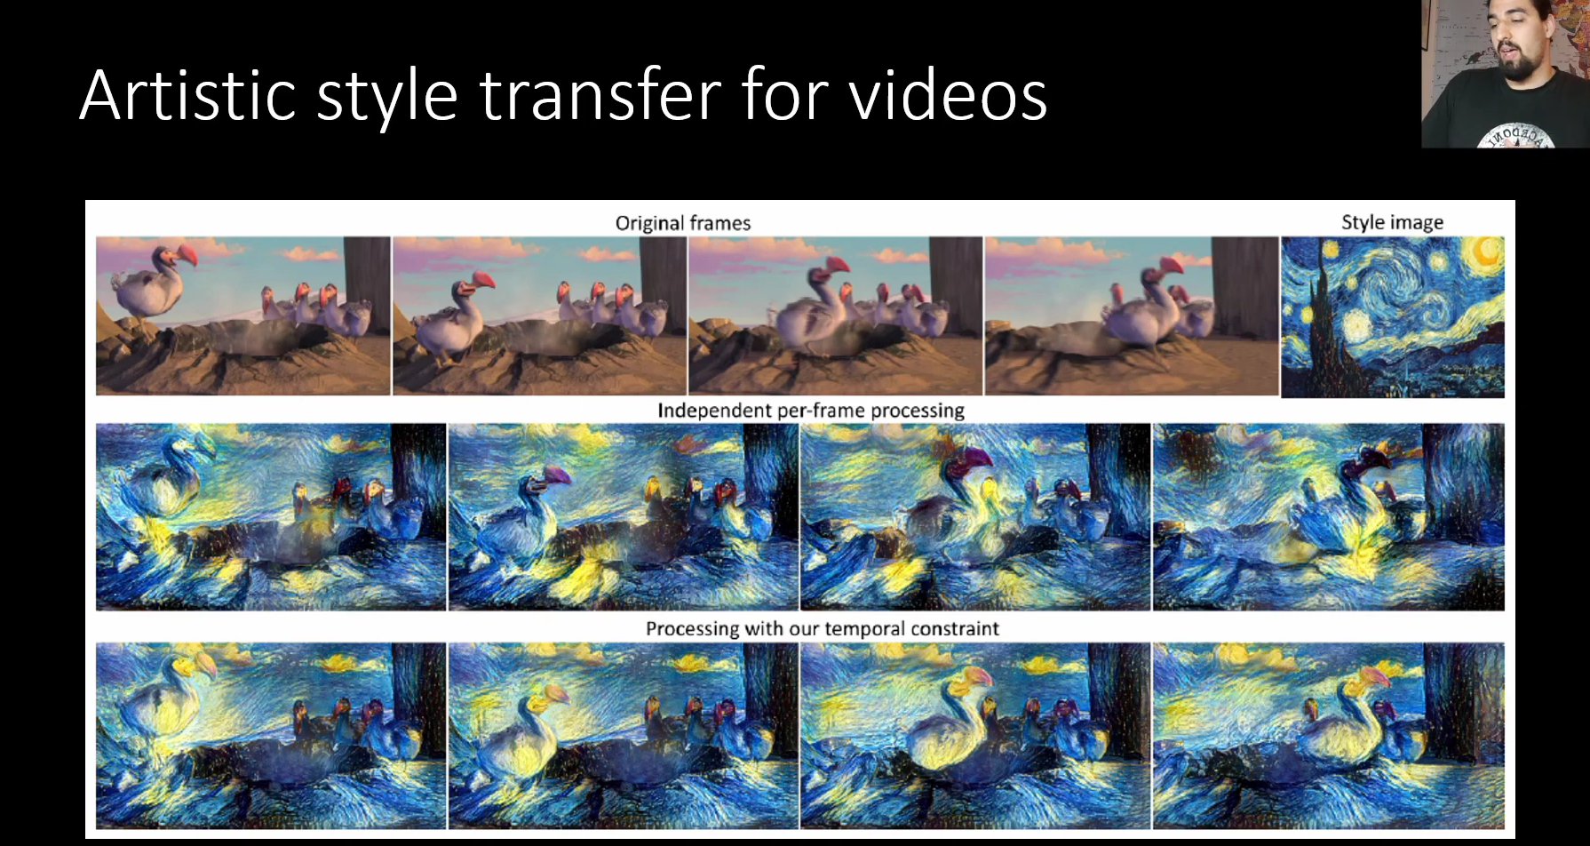

Slide 23
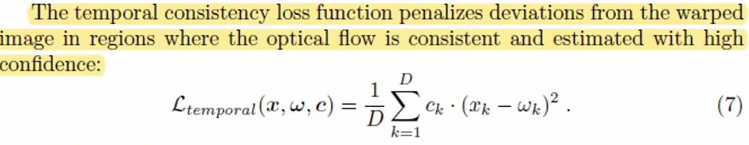

Slide 24
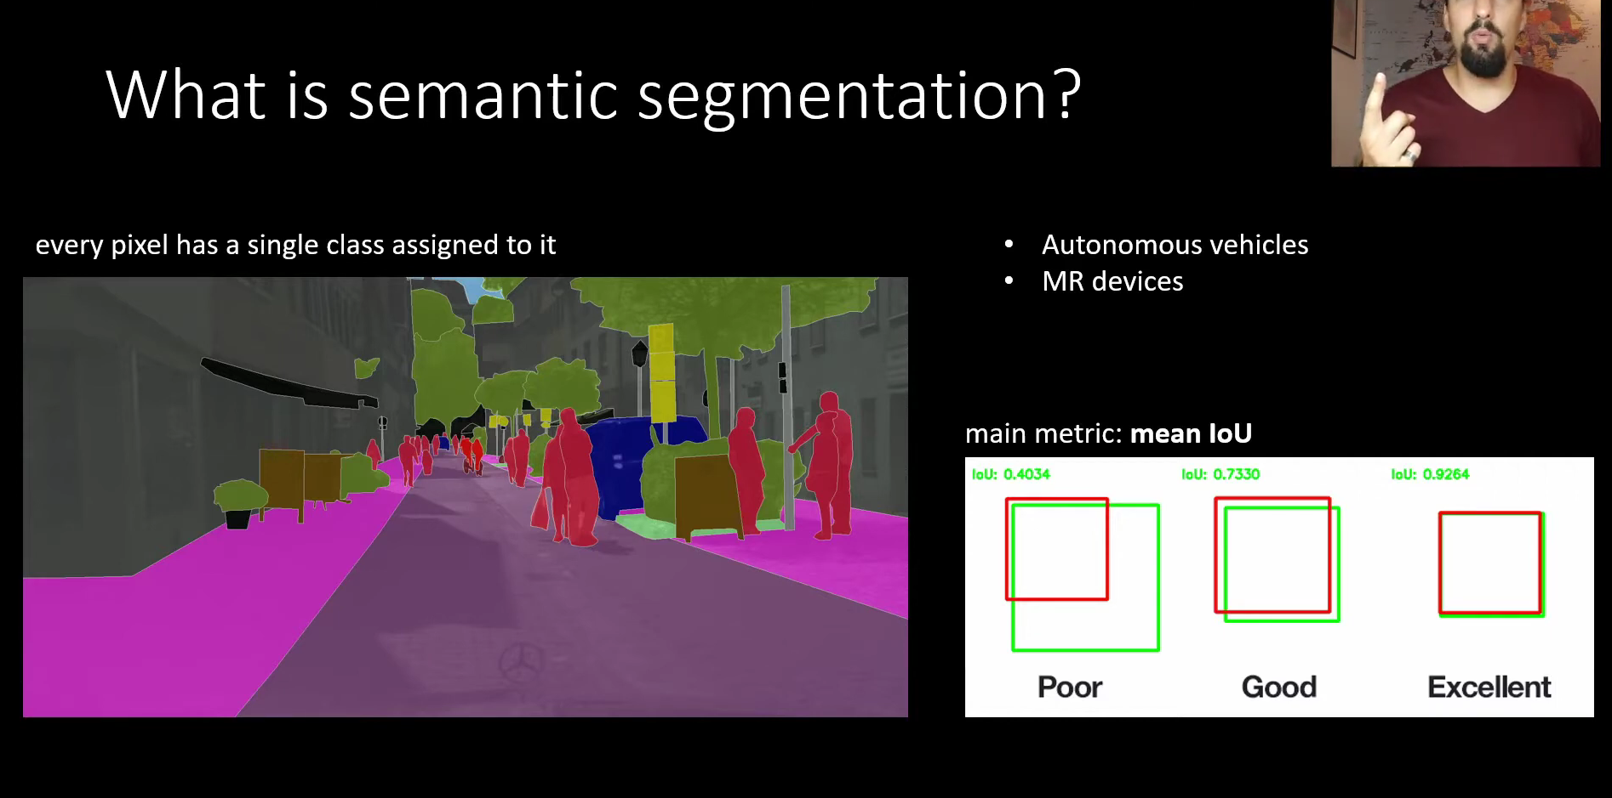

Slide 25
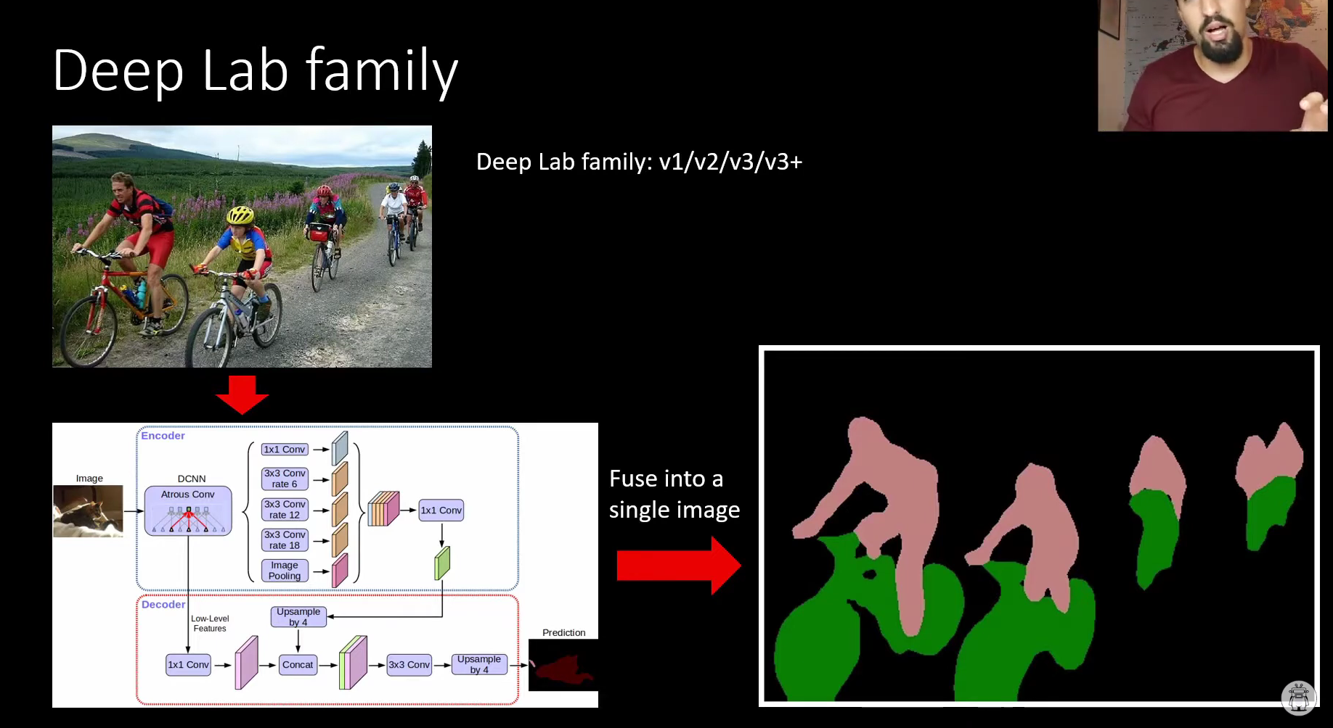

Slide 26
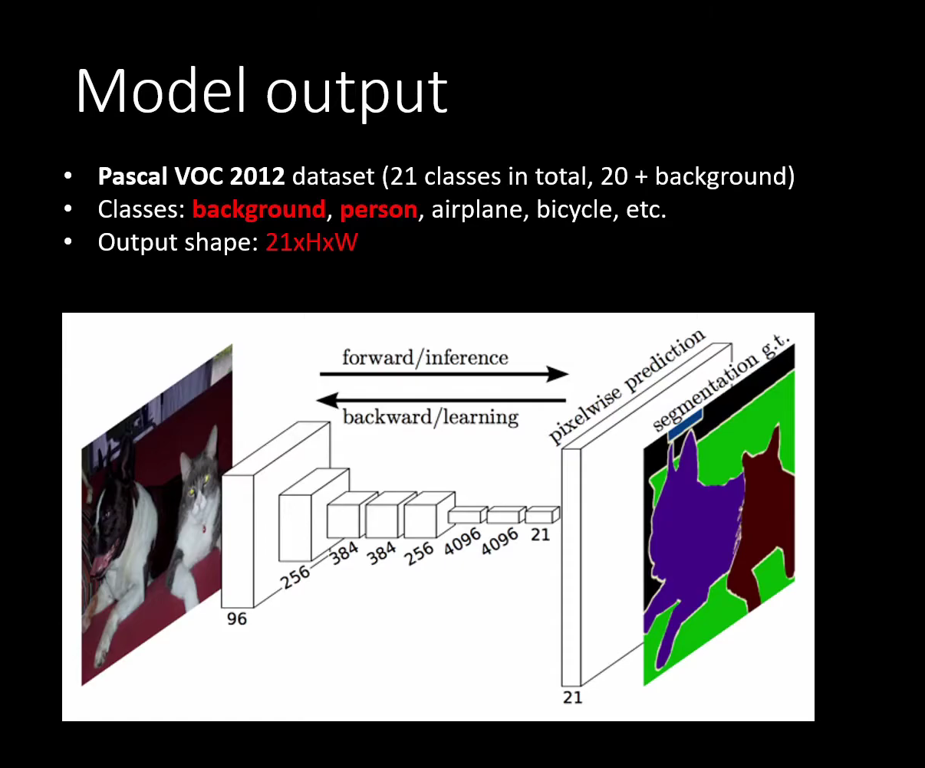

Slide 27
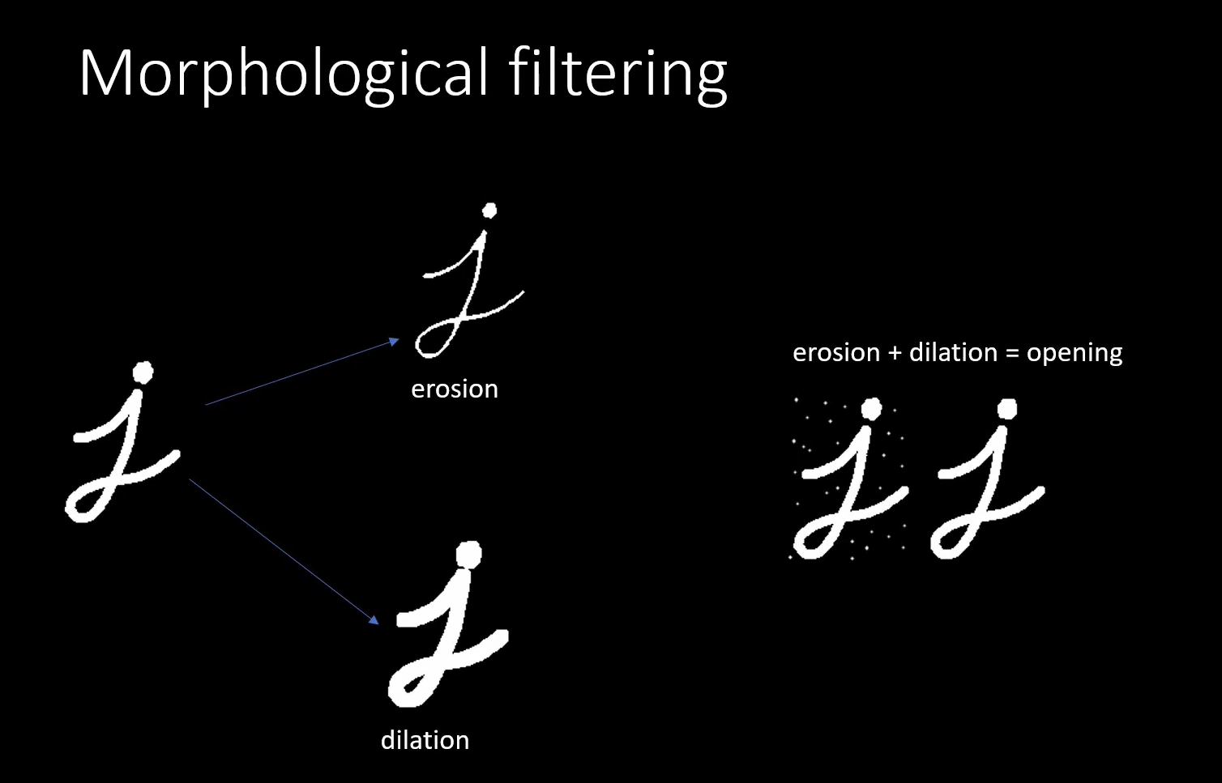

Slide 28
